Slide 1
Software Connectors
Software Architecture
Lecture 7

Slide 2
What is a Software Connector?
Architectural element that models
  Interactions among components
  Rules that govern those interactions
Simple interactions
  Procedure calls
  Shared variable access
Complex & semantically rich interactions
  Client-server protocols
  Database access protocols
  Asynchronous event multicast
Each connector provides
  Interaction duct(s)
  Transfer of control and/or data

Slide 3
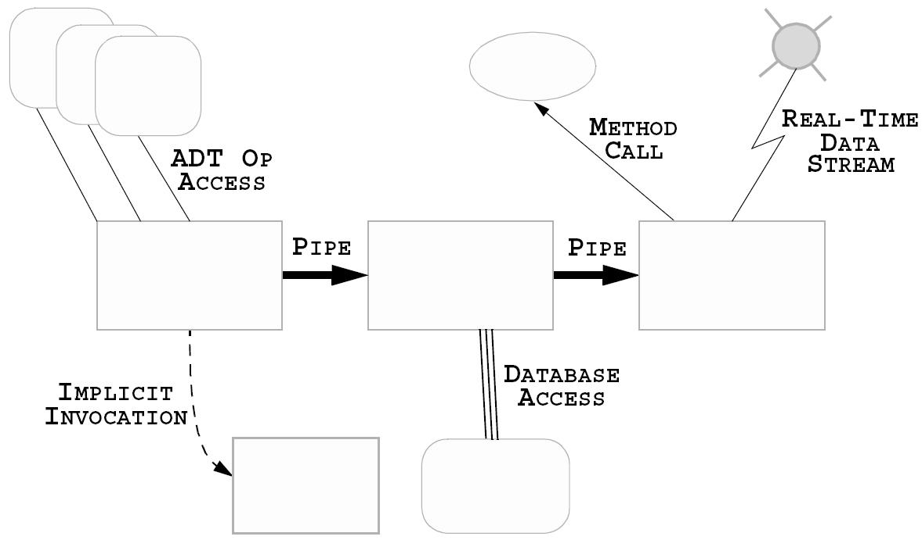
Where are Connectors in Software Systems?
Software Architecture: Foundations, Theory, and Practice; Richard N. Taylor, Nenad Medvidovic, and Eric M. Dashofy; © 2008 John Wiley & Sons, Inc. Reprinted with permission.

Slide 4
Implemented vs. Conceptual Connectors
Connectors in software system implementations
  Frequently no dedicated code
  Frequently no identity
  Typically do not correspond to compilation units
  Distributed implementation
    Across multiple modules
    Across interaction mechanisms

Slide 5
Implemented vs. Conceptual Connectors (cont’d)
Connectors in software architectures
  First-class entities
  Have identity
  Describe all system interaction
  Entitled to their own specifications & abstractions

Slide 6
Reasons for Treating Connectors Independently
Connector ≠ Component
  Components provide application-specific functionality
  Connectors provide application-independent interaction mechanisms
Interaction abstraction and/or parameterization
Specification of complex interactions
  Binary vs. N-ary
  Asymmetric vs. Symmetric
  Interaction protocols

Slide 7
Treating Connectors Independently (cont’d)
Localization of interaction definition
Extra-component system (interaction) information
Component independence
Component interaction flexibility

Slide 8
Benefits of First-Class Connectors
Separate computation from interaction
Minimize component interdependencies
Support software evolution
  At component-, connector-, & system-level
Potential for supporting dynamism
Facilitate heterogeneity
Become points of distribution
Aid system analysis & testing

Slide 9
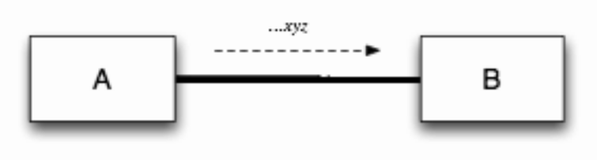
An Example of Explicit Connectors
Software Architecture: Foundations, Theory, and Practice; Richard N. Taylor, Nenad Medvidovic, and Eric M. Dashofy; © 2008 John Wiley & Sons, Inc. Reprinted with permission.

Slide 10

An Example of Explicit Connectors (cont’d)
?
Software Architecture: Foundations, Theory, and Practice; Richard N. Taylor, Nenad Medvidovic, and Eric M. Dashofy; © 2008 John Wiley & Sons, Inc. Reprinted with permission.

Slide 11
Software Connector Roles
Locus of interaction among set of components
Protocol specification (sometimes implicit) that defines its properties
  Types of interfaces it is able to mediate
  Assurances about interaction properties
  Rules about interaction ordering
  Interaction commitments (e.g., performance)
Roles
  Communication
  Coordination
  Conversion
  Facilitation

Slide 12
Connectors as Communicators
Main role associated with connectors
Supports
  Different communication mechanisms
    e.g. procedure call, RPC, shared data access, message passing
  Constraints on communication structure/direction
    e.g. pipes
  Constraints on quality of service
    e.g. persistence
Separates communication from computation
May influence non-functional system characteristics
  e.g. performance, scalability, security

Slide 13
Connectors as Coordinators
Determine computation control
Control delivery of data
Separates control from computation
Orthogonal to communication, conversion, and facilitation
  Elements of control are in communication, conversion and facilitation

Slide 14
Connectors as Converters
Enable interaction of independently developed, mismatched components
Mismatches based on interaction
  Type
  Number
  Frequency
  Order
Examples of converters
  Adaptors
  Wrappers

Slide 15
Connectors as Facilitators
Enable interaction of components intended to interoperate
  Mediate and streamline interaction
Govern access to shared information
Ensure proper performance profiles
  e.g., load balancing
Provide synchronization mechanisms
  Critical sections
  Monitors

Slide 16
Connector Types
Procedure call
Data access
Event
Stream
Linkage
Distributor
Arbitrator
Adaptor

Slide 17
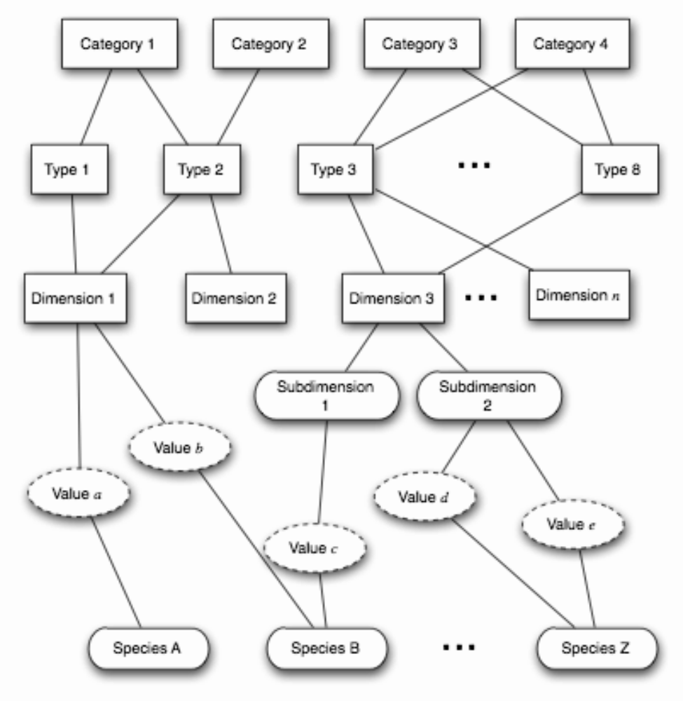
A Framework for Classifying Connectors
Software Architecture: Foundations, Theory, and Practice; Richard N. Taylor, Nenad Medvidovic, and Eric M. Dashofy; © 2008 John Wiley & Sons, Inc. Reprinted with permission.

Slide 18
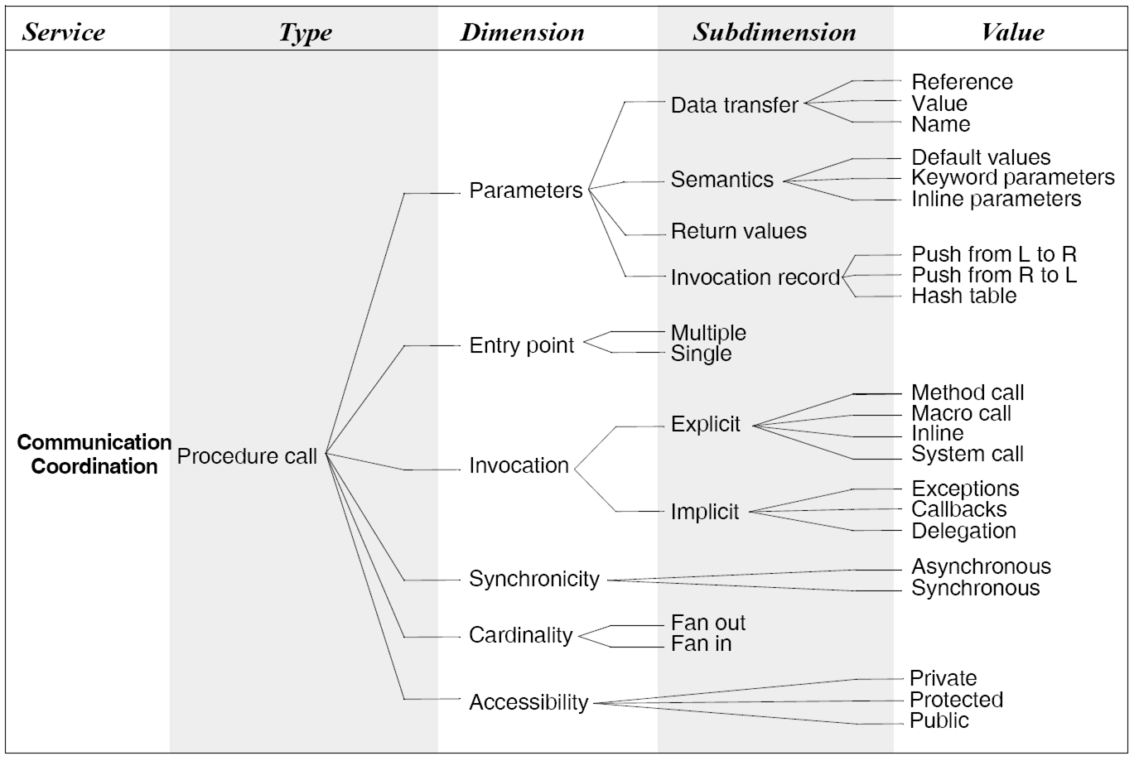
Procedure Call Connectors
Software Architecture: Foundations, Theory, and Practice; Richard N. Taylor, Nenad Medvidovic, and Eric M. Dashofy; © 2008 John Wiley & Sons, Inc. Reprinted with permission.

Slide 19
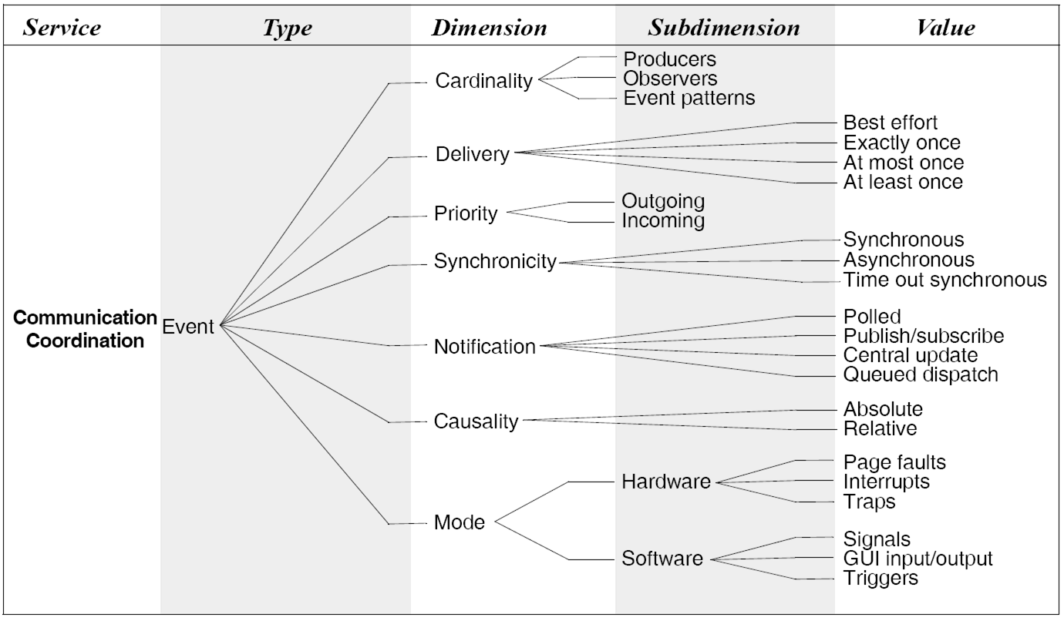
Event Connectors
Software Architecture: Foundations, Theory, and Practice; Richard N. Taylor, Nenad Medvidovic, and Eric M. Dashofy; © 2008 John Wiley & Sons, Inc. Reprinted with permission.

Slide 20
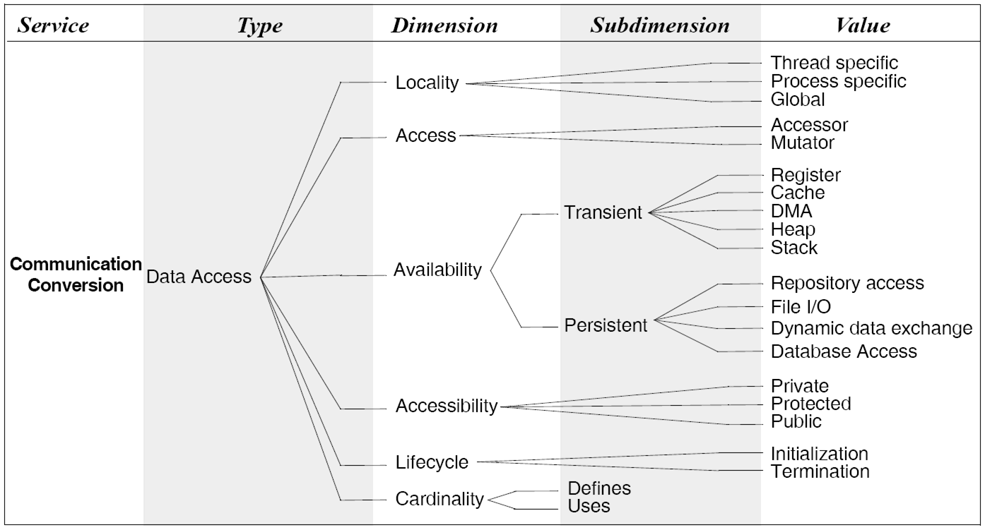
Data Access Connectors
Software Architecture: Foundations, Theory, and Practice; Richard N. Taylor, Nenad Medvidovic, and Eric M. Dashofy; © 2008 John Wiley & Sons, Inc. Reprinted with permission.

Slide 21
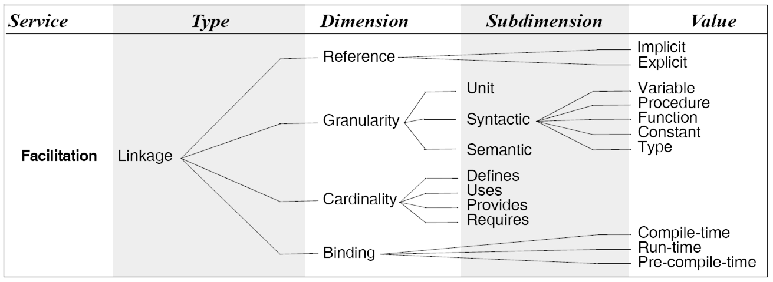
Linkage Connectors
Software Architecture: Foundations, Theory, and Practice; Richard N. Taylor, Nenad Medvidovic, and Eric M. Dashofy; © 2008 John Wiley & Sons, Inc. Reprinted with permission.

Slide 22
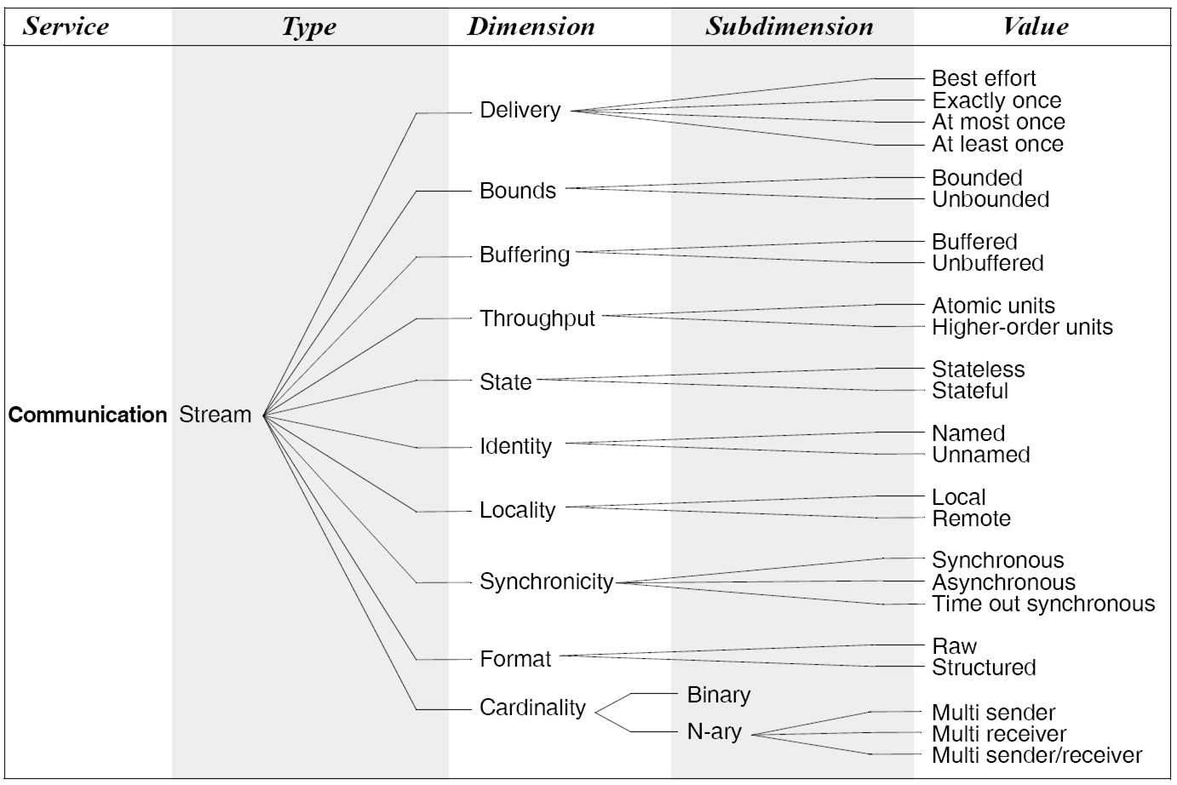
Stream Connectors
Software Architecture: Foundations, Theory, and Practice; Richard N. Taylor, Nenad Medvidovic, and Eric M. Dashofy; © 2008 John Wiley & Sons, Inc. Reprinted with permission.

Slide 23
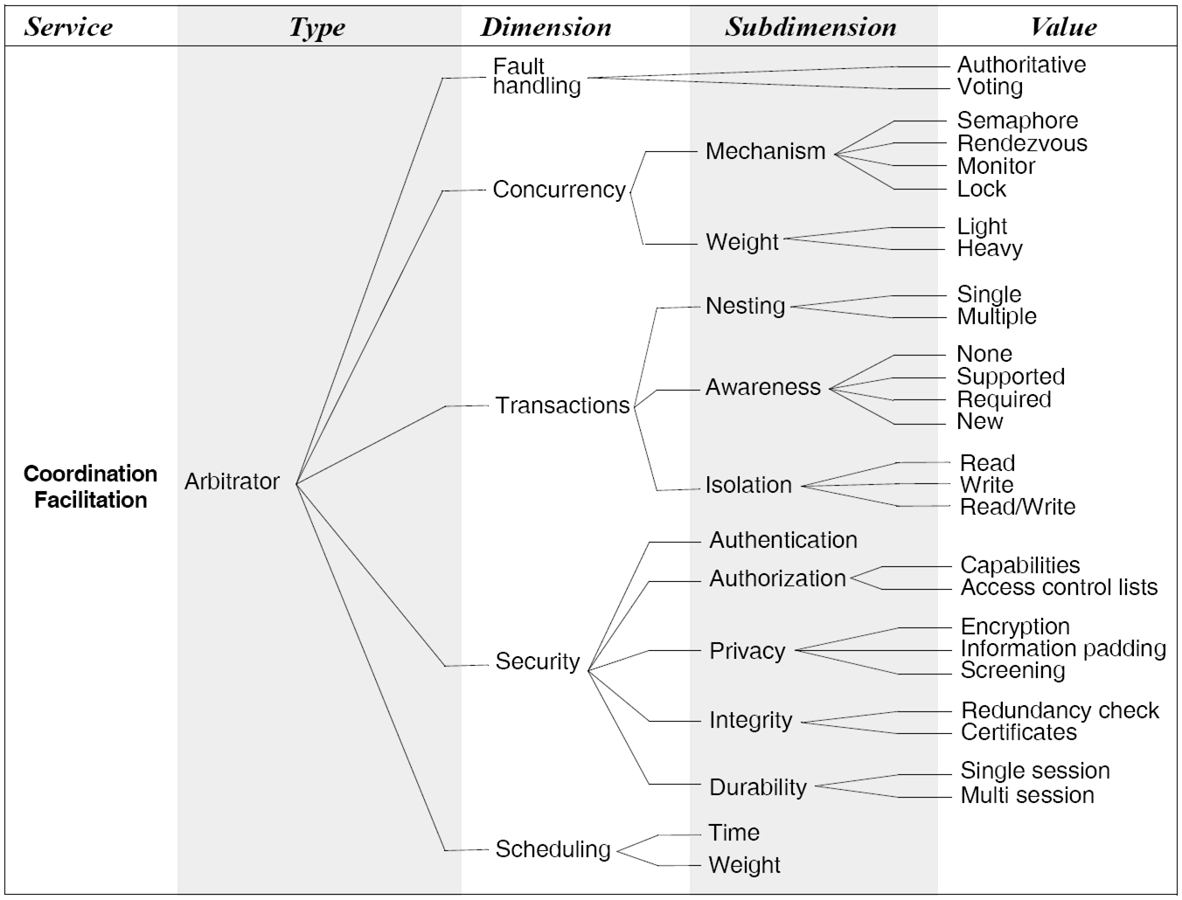
Arbitrator Connectors
Software Architecture: Foundations, Theory, and Practice; Richard N. Taylor, Nenad Medvidovic, and Eric M. Dashofy; © 2008 John Wiley & Sons, Inc. Reprinted with permission.

Slide 24
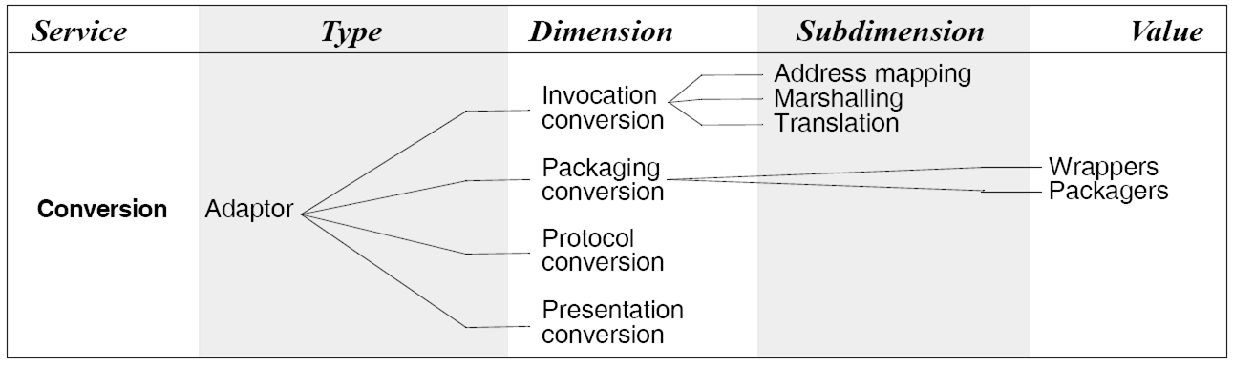
Adaptor Connectors
Software Architecture: Foundations, Theory, and Practice; Richard N. Taylor, Nenad Medvidovic, and Eric M. Dashofy; © 2008 John Wiley & Sons, Inc. Reprinted with permission.

Slide 25
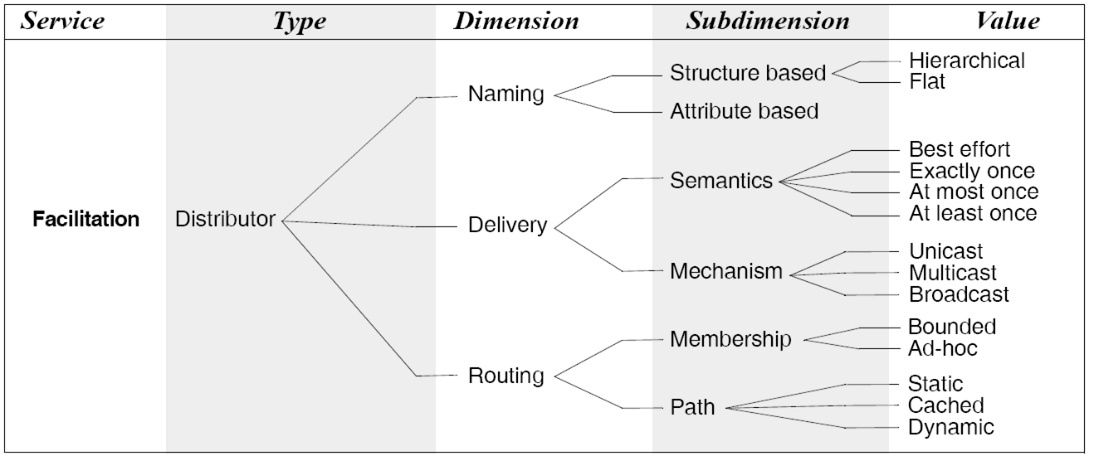
Distributor Connectors
Software Architecture: Foundations, Theory, and Practice; Richard N. Taylor, Nenad Medvidovic, and Eric M. Dashofy; © 2008 John Wiley & Sons, Inc. Reprinted with permission.

Slide 26
Discussion
Connectors allow modeling of arbitrarily complex interactions
Connector flexibility aids system evolution
  Component addition, removal, replacement, reconnection, migration
Support for connector interchange is desired
  Aids system evolution
  May not affect system functionality

Slide 27
Discussion
Libraries of OTS connector implementations allow developers to focus on application-specific issues
Difficulties
  Rigid connectors
  Connector “dispersion” in implementations
Key issue
  Performance vs. flexibility

